Slide 1

Fish Species Identification Using a CNN Model Trained on Keras API
Abdulrahman

Slide 2
Problem
Data *Given
Keras *Solution
Challenges
Ways to improve
Demo

Slide 3

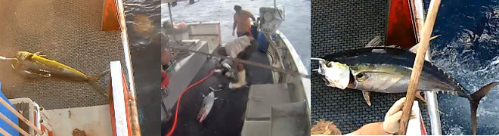
60% of the world’s tuna is caught in the Western and Central Pacific, illegally, unreported. The Nature Conservancy is using cameras to monitor these fishing activities, and it's inviting the Kaggle community to develop algorithms to automatically detect and classify species of tunas, sharks...etc. to protect out plant.

Slide 4

The data
https://www.kaggle.com/c/the-nature-conservancy-fisheries-monitoring

Slide 5
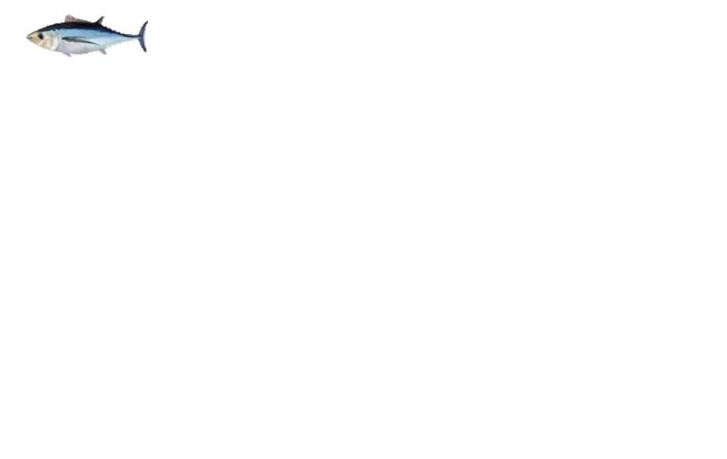
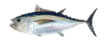



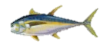
ALB: Albacore Tuna
BET: Bigeye Tuna
DOL: Dolphinfish, Mahi Mahi
LAG: Opah, Moonfish
Shark
YFT: Yellowfin Tuna
Other

Slide 6
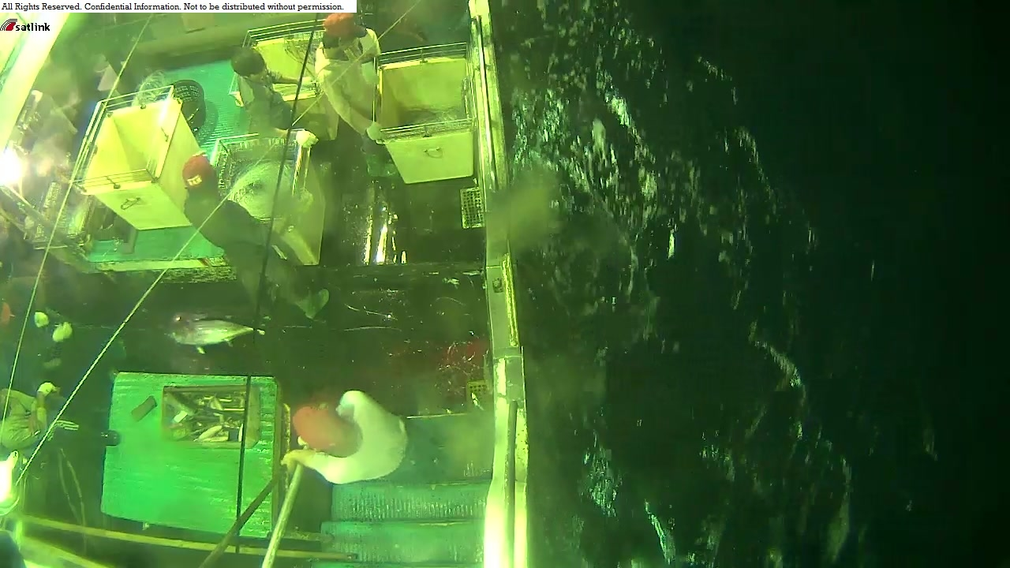

Slide 7
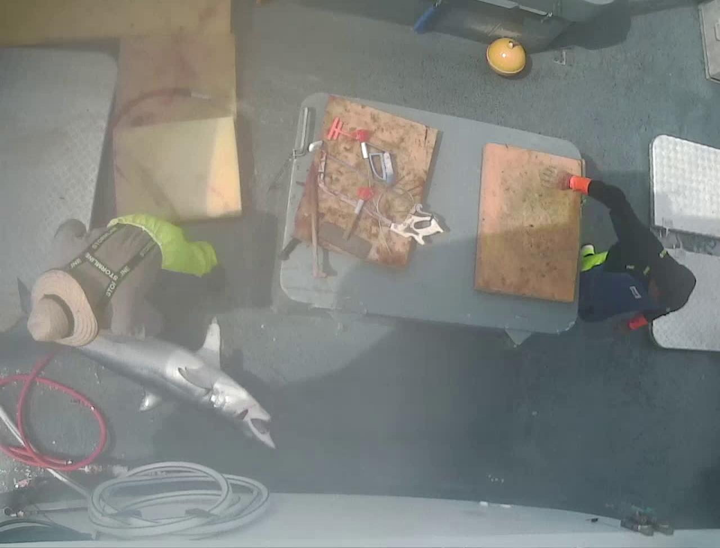

Slide 8
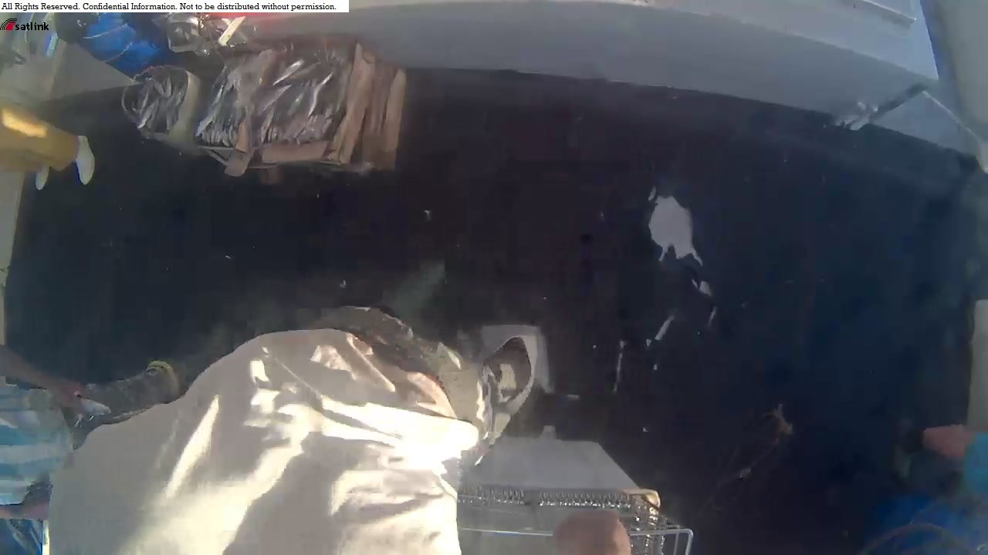

Slide 9
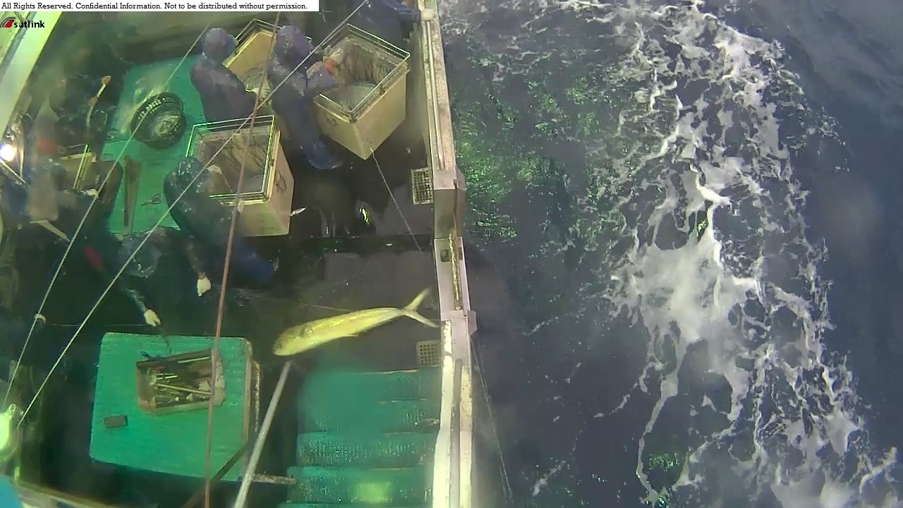

Slide 10
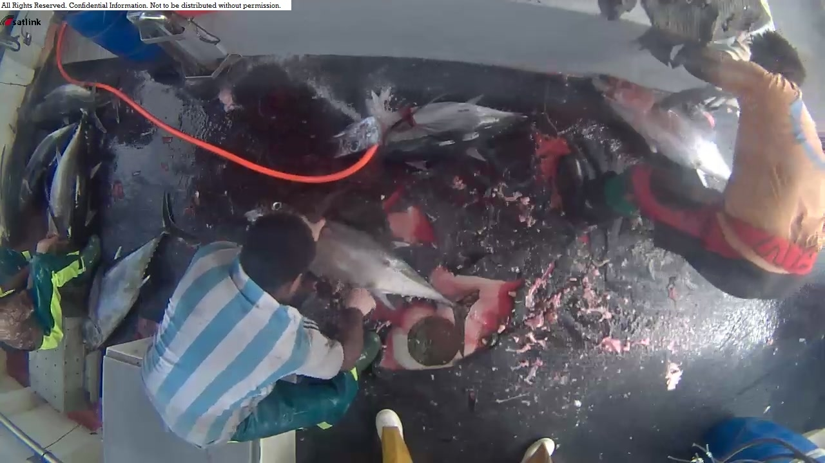

Slide 11


Slide 12
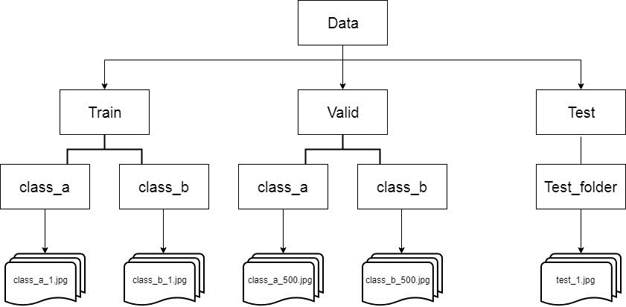
https://medium.com/@vijayabhaskar96/tutorial-image-classification-with-keras-flow-from-directory-and-generators-95f75ebe5720

Slide 13
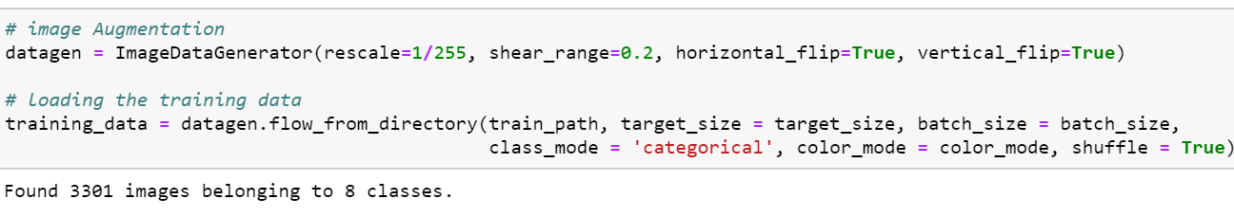
https://medium.com/@vijayabhaskar96/tutorial-image-classification-with-keras-flow-from-directory-and-generators-95f75ebe5720

Slide 14
CNN Models

Slide 15
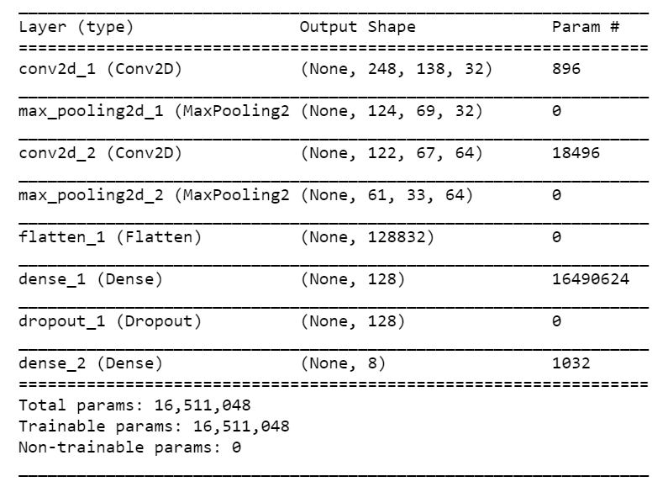
https://www.pluralsight.com/courses/keras-deep-learning

Slide 16

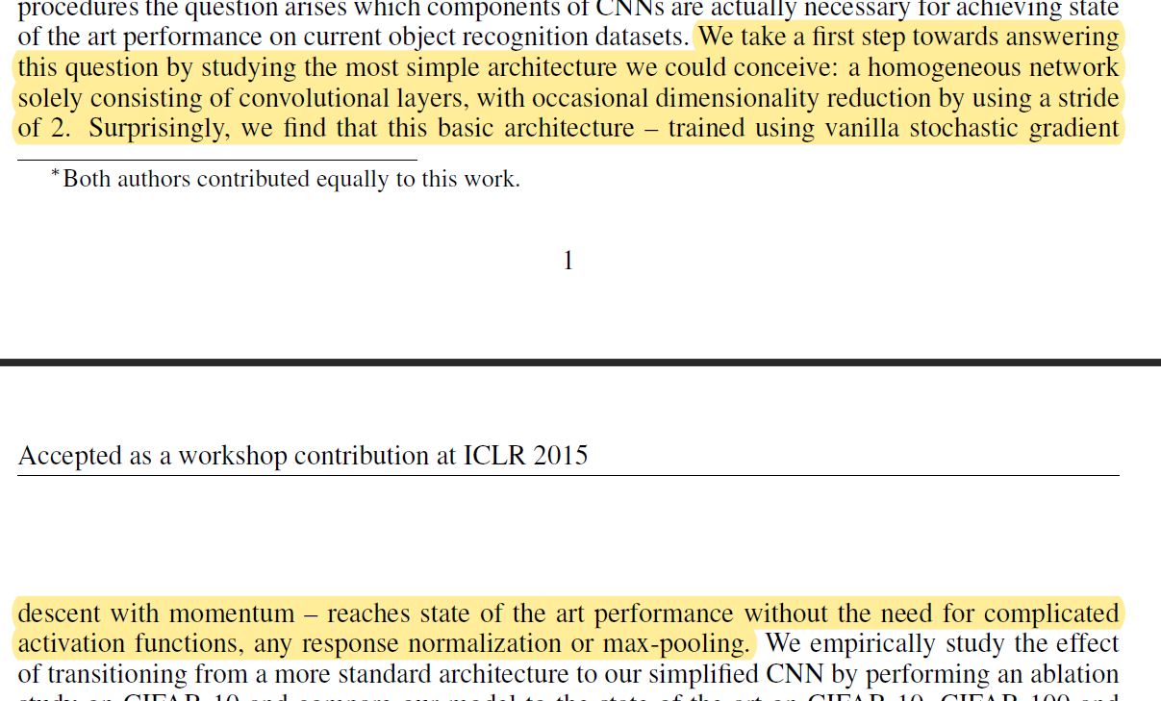
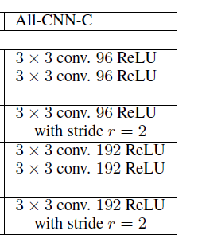
https://arxiv.org/pdf/1412.6806.pdf

Slide 17
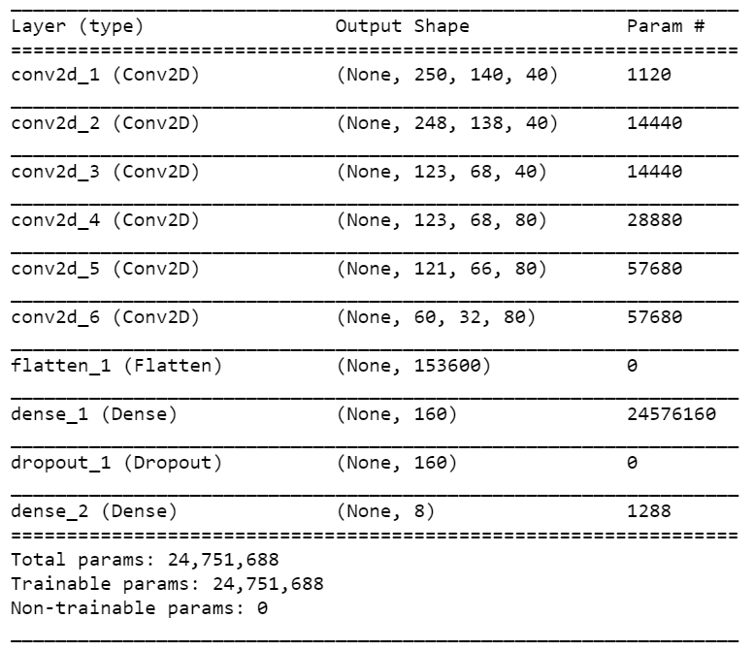

Slide 18
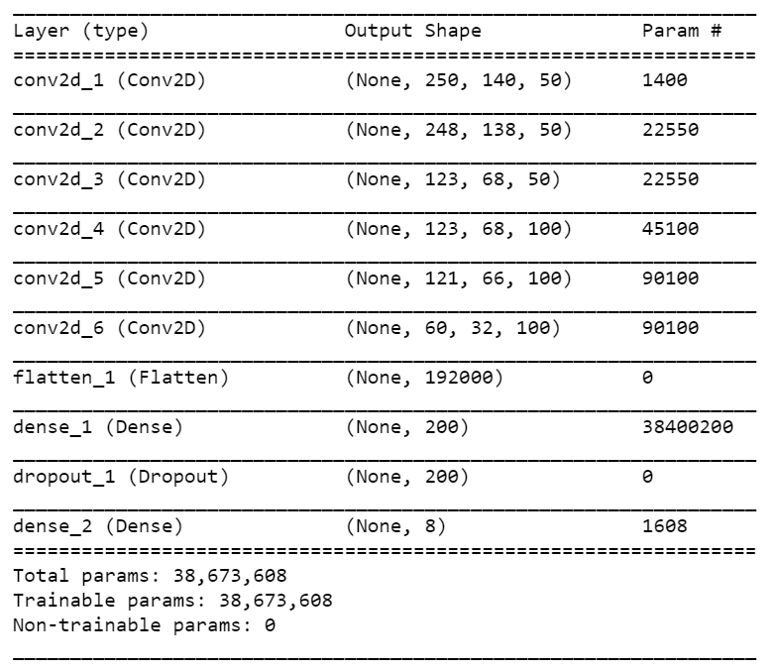

Slide 19
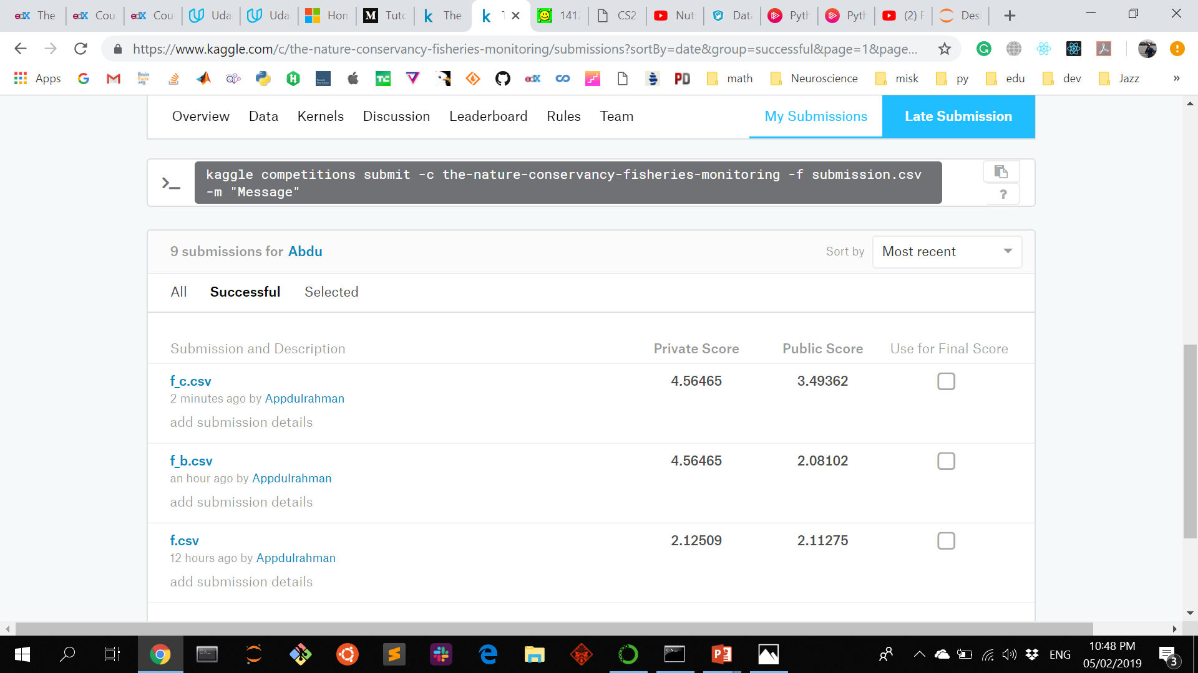
280/389 ~ top 70%

Slide 20
Challenges
Pillow
Generating images from the files
Submitting the results to Kaggle in the right format
Installation
Training the model
Submitting the results to Kaggle

Slide 21
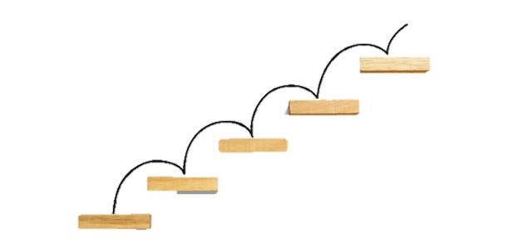
Improvements
Training images.
Live video predictions
Better models
Deployment on Flask

Slide 22
Live Demo

Slide 23
Thanks!!

